Slide 1

Loan Management System
Microservices-Based, Event-Driven Financial Platform
A production-ready loan management system demonstrating enterprise-grade backend architecture with microservices, event-driven processing, and secure authentication. Built for real-world banking, NBFC, and FinTech applications.
Architecture Excellence
Security First
Real-world enterprise design with separation of concerns using microservices
JWT-based authentication and role-based authorization throughout
Event-Driven Core
Full-Stack Integration
Asynchronous processing using Apache Kafka for scalability
Angular frontend seamlessly integrated with backend services

Slide 2
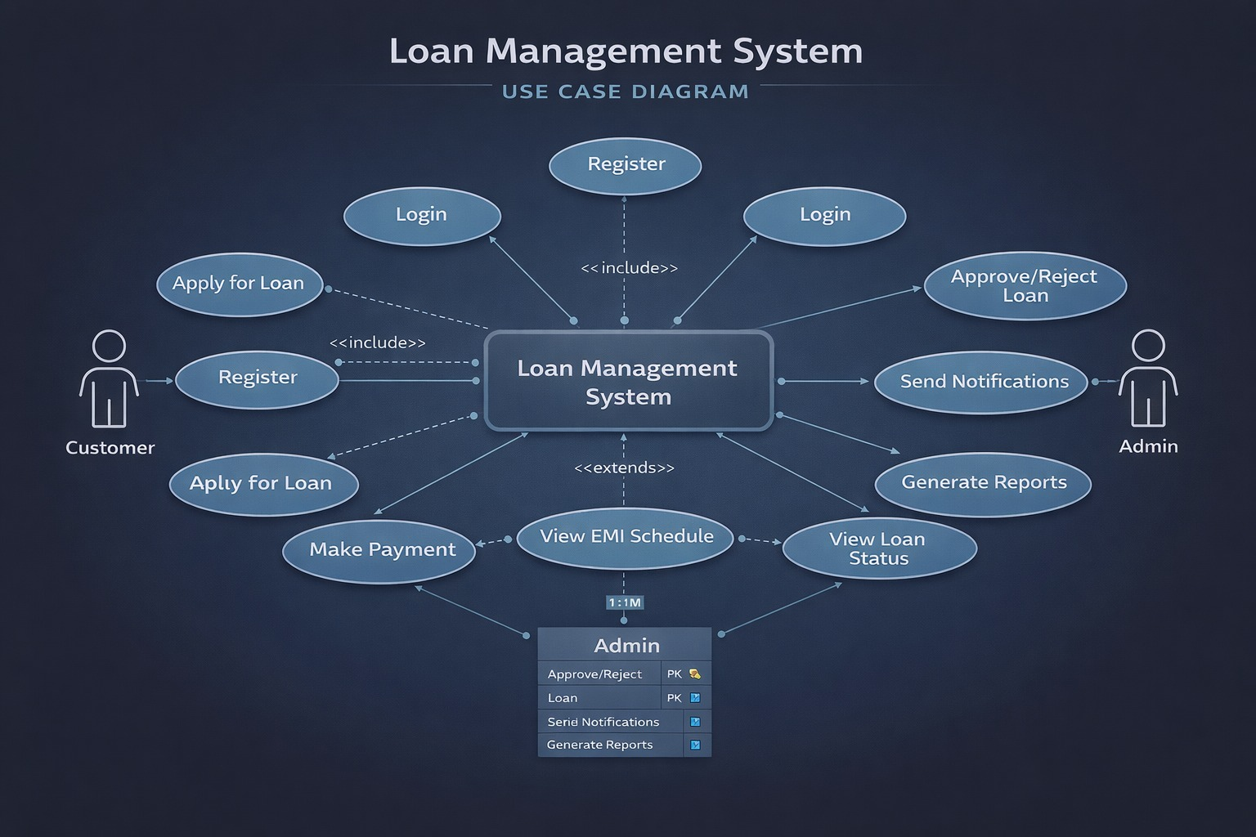

Slide 3

CHALLENGE
Operational Challenges in Traditional Systems
Operational Bottlenecks
Technical Limitations
Loan approval requires multiple manual intervention steps
Monolithic architecture limits flexibility and deployment speed
EMI miscalculations occur frequently due to human error
No centralized tracking system for complete loan lifecycle
Tight coupling between modules increases failure risk
High coupling creates dependencies between business modules
Single database becomes a bottleneck under load
Lack of event-driven processing delays critical workflows
System struggles to scale during peak demand periods
No independent service scaling capabilities
These challenges compound in high-volume financial environments, where delayed processing and errors directly impact customer satisfaction and regulatory compliance.

Slide 4



SOLUTION
Our Microservices Solution Approach
Design Philosophy
Key Improvements
Single Responsibility: One service handles one business capability
Automated Processing: Loan workflows execute without manual intervention
Resilience: Services fail fast and recover independently
Event-Based Flow: Approvals and notifications triggered by business events
Asynchronous: Non-blocking operations wherever possible
Independent Scaling: Each service scales based on its own demand
Decoupled: Loose coupling through event-driven communication
Centralized Config: Configuration managed in one location
Secure Access: Token-based authentication across all endpoints

Slide 5
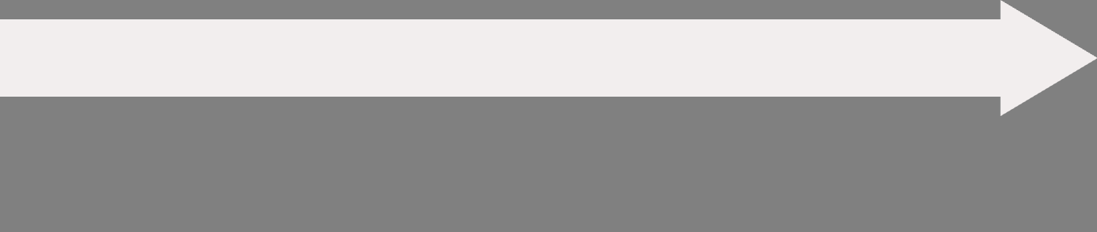
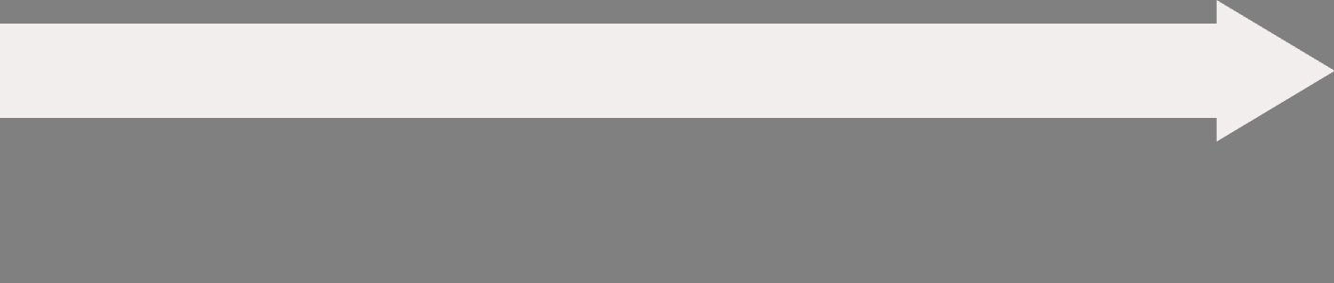
ARCHITECTURE
High-Level System Architecture
Our system follows a layered architecture pattern, with clear separation between client, gateway, services, and data layers. Each layer has distinct responsibilities and communicates through well-defined interfaces.
Gateway Layer
Client Layer
API Gateway serves as the single entry point, handling request routing, load balancing, and authentication validation before forwarding to services.
Angular Web Application provides the user interface with JWT-secured API calls ensuring every request is authenticated and authorized.
Data Layer
Service Layer
Database Per Service pattern ensures data independence—each service owns its schema with no shared tables across services.
Business Microservices implement core domain logic, communicating via REST APIs and asynchronous Kafka events for loose coupling.

Slide 6
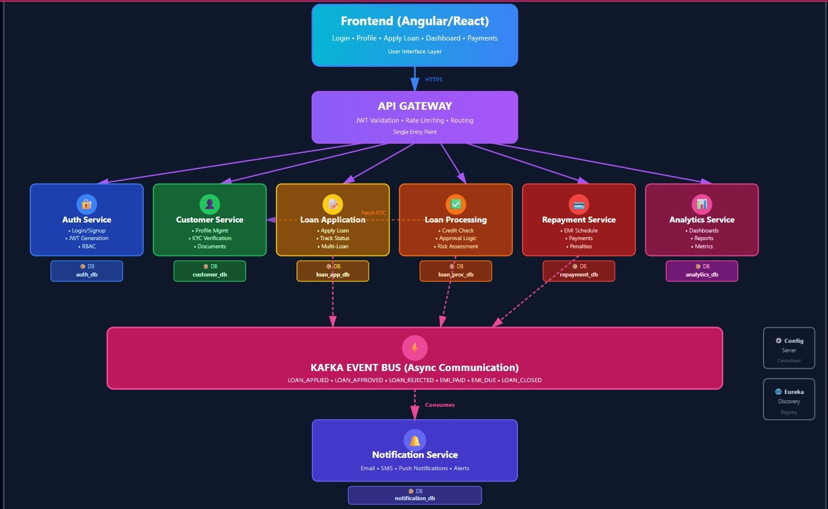


Slide 7
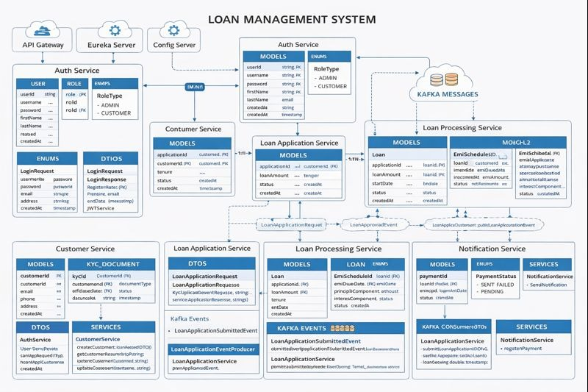


Slide 8
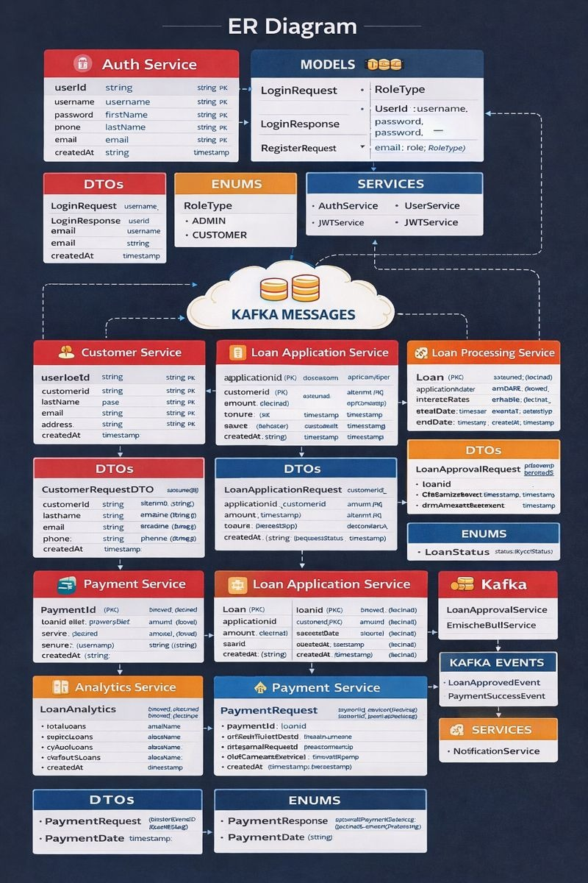


Slide 9
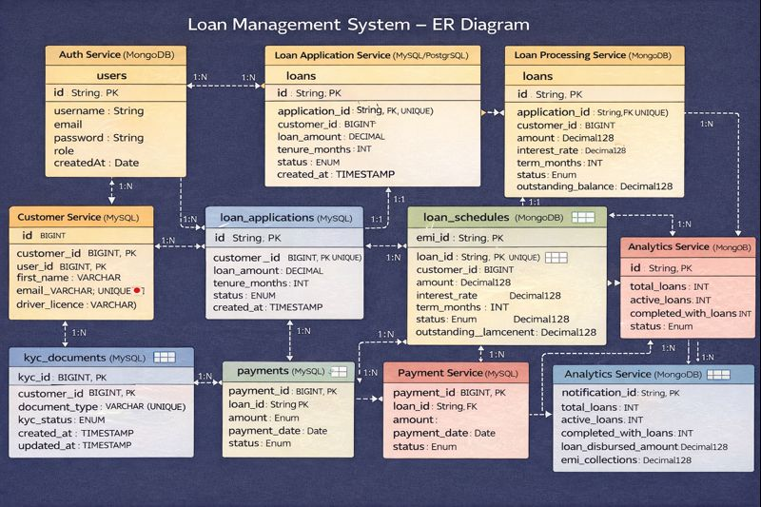

Slide 10




Why Microservices Over Monolith?
Monolithic Limitations
Microservices Advantages
Single Point of Failure
One bug can bring down the entire application
Independent Deployments
Scaling Challenges
Deploy and update services without affecting others
Must scale entire application even if only one module needs capacity
Slow Deployments
Technology Flexibility
Every change requires full system redeployment and testing
Choose the best tech stack for each service's needs
Technology Lock-in
Difficult to adopt new technologies or frameworks
Better Fault Tolerance
Failures are isolated and don't cascade across system
Horizontal Scalability
Scale individual services based on specific demand patterns

Slide 11
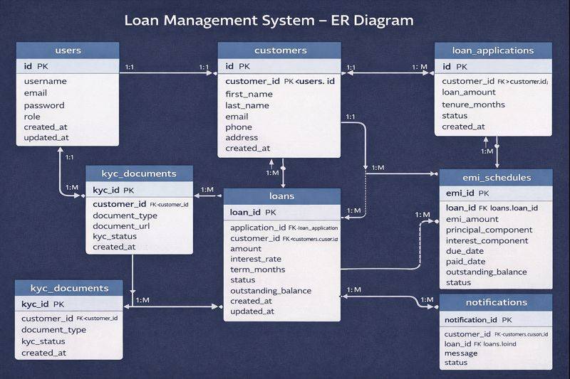

Slide 12







AUTH SERVICE
Authentication Service Deep Dive
Token Lifecycle
Manages JWT creation, validation, refresh, and expiration throughout user sessions
Identity Management
Handles user registration, login, and profile management with secure credential storage
Role Enforcement
Implements role-based access control with claims embedded in JWT tokens
Key Components & Security Rules
Core Components
Security Implementation
JWTService: Handles token generation with configurable expiration and signature validation
Password Protection: BCrypt hashing with configurable work factor
UserService: Manages CRUD operations for user accounts and profile data
Token Expiration: Automatic invalidation after configurable timeout period
AuthController: Exposes REST endpoints for login, registration, and token refresh
Role Claims: User roles embedded directly inside JWT claims for stateless authorization
Secure Headers: CORS and security headers configured on all endpoints

Slide 13





CUSTOMER SERVICE
Customer Service Deep Dive
The Customer Service acts as the single source of truth for customer identity and KYC data. It provides immutable customer records that other services reference throughout the loan lifecycle.
Customer Model
KYC Handling
Validation Rules
Stores immutable customer identity including personal details, contact information, and unique identifiers used as foreign keys across services
Manages document upload, verification workflow, and approval status—KYC completion is mandatory before any loan approval
Enforces email uniqueness, phone number format validation, and ensures customer record exists before loan requests
Customer records are never deleted—only marked as inactive—to maintain historical data integrity and audit trails for regulatory compliance.

Slide 14
LOAN APPLICATION
Loan Application Service Deep Dive
This service serves as the entry point for the loan lifecycle, capturing customer loan requests and enforcing initial business rules before processing begins.
1
2
3
Application Submission
Business Validation
Event Publication
Customer submits loan request with amount, tenure preference, and purpose. System validates customer eligibility and active application status.
Enforces tenure options (12, 24, or 36 months), minimum loan amount thresholds, and one-active-application-per-customer rule.
Upon successful validation, publishes LoanApplicationSubmittedEvent to Kafka for asynchronous processing by downstream services.
LoanApplication Model
Core Fields
Business Constraints
applicationId
Tenure Options: 12, 24, or 36 months only
customerId
Amount Validation: Must exceed minimum threshold defined in configuration
loanAmount
Application Limit: One active application per customer at any time
tenure
status
Status Tracking: Moves through SUBMITTED → APPROVED/REJECTED states
createdAt

Slide 15
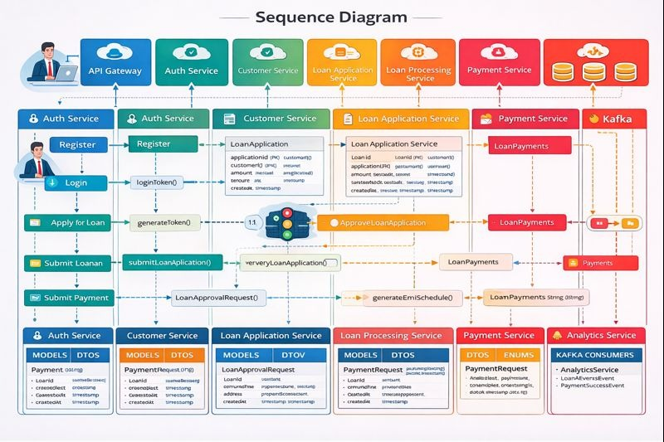

Slide 16

PROCESSING
Loan Processing Service Deep Dive
This service contains the heavyweight business logic for loan approval, executing complex eligibility checks and generating complete EMI schedules.
Event Consumption
EMI Generation
Listens for LoanApplicationSubmittedEvent from Kafka, triggering the processing workflow asynchronously
Calculates monthly EMI using interest rate and tenure, then generates complete payment schedule with principal/interest split
1
2
3
4
Eligibility Checks
Loan Creation
Performs credit score validation, income verification, debt-to-income ratio calculation, and KYC status confirmation
Creates approved Loan entity with ACTIVE status, stores EMI schedule, and publishes LoanApprovedEvent
Loan Lifecycle States
Why Separate Service?
CREATED → ACTIVE → CLOSED / DEFAULTED
Heavy Logic: Complex calculations isolated from other services
Loans move through defined states with specific business rules governing each transition and rollback scenarios.
Independent Scaling: Can scale during high application volume
Maintainability: Easier to update approval rules without touching other services

Slide 17


EMI ENGINE
EMI Calculation Engine
The EMI calculation engine is the mathematical core of loan processing, computing monthly payment amounts and generating complete amortization schedules with principal and interest breakdowns.
Standard EMI Formula
Where P is principal amount, R is monthly interest rate, and N is tenure in months.
01
02
Interest Rate Conversion
EMI Computation
Convert annual interest rate to monthly rate by dividing by 12 and converting percentage to decimal
Apply formula to calculate fixed monthly payment amount that remains constant throughout loan tenure
03
04
Component Split
Schedule Storage
For each payment, calculate interest component on remaining balance, then derive principal component as difference
Store each EMI as separate database record with payment date, amounts, and remaining balance for tracking
Each EMI record tracks the principal component, interest component, payment due date, and remaining loan balance after payment—enabling precise financial tracking and reporting throughout the loan lifecycle.

Slide 18





Payment Service Architecture
Payment Processing Flow
User Selection
Customer selects EMI payment option from available plans
Request Sent
Payment request transmitted with user credentials and amount
Status Validated
System verifies loan status, eligibility, and payment conditions
Balance Updated
Outstanding balance adjusted in real-time upon successful validation
Event Published
Kafka event broadcast to notify downstream services of payment completion
This asynchronous flow ensures zero data inconsistency through intelligent retry logic and comprehensive payment status tracking at every stage.

Slide 19

Analytics Service: CQRS in Action
Why Separate Analytics?
Key Metrics Generated
Read-heavy service: Optimized for high-volume queries without impacting transaction processing
15K+
$2.4M
Zero transactional load: Isolated from write operations to prevent performance bottlenecks
Total Loans Issued
EMI Collected
Event-based updates: Consumes Kafka events for eventual consistency
Lifetime loan origination count
Total payment volume processed
2.3%
8.2K
We implement CQRS (Command Query Responsibility Segregation) to completely separate read and write concerns.
Default Rate
Active Loans
Portfolio risk indicator
Current outstanding accounts

Slide 20
Notification Service Design
Event Consumers
Delivery Channels
Architecture Benefits
The notification service subscribes to critical business events:
Multi-channel notification strategy:
Email notifications (future-ready with template engine)
Decoupled design advantages:
LoanApprovedEvent – Triggers approval notifications
No direct dependencies on business services
In-app notifications (real-time user alerts)
PaymentSuccessEvent – Confirms EMI transactions
Guaranteed delivery via Kafka's persistence layer
SMS gateway (planned integration)
LoanRejectedEvent – Sends rejection alerts
Fault tolerance with automatic retry mechanisms

Slide 21
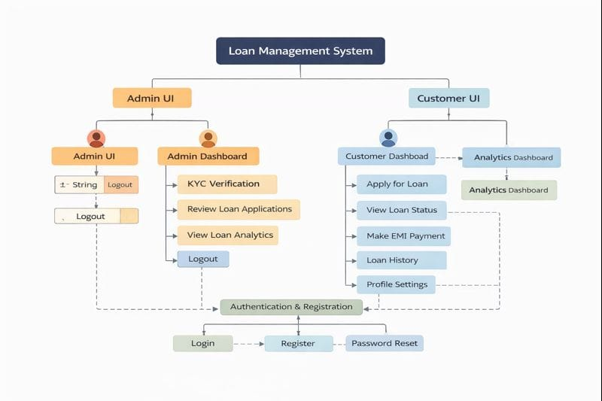

Slide 22
Kafka: The Event Backbone
loan-application-events
1
Captures new loan requests and initial customer data submissions for processing pipeline
2
loan-approval-events
Broadcasts approval/rejection decisions with risk assessment metadata to all subscribers
payment-events
3
Publishes EMI transactions, balance updates, and payment confirmations across the ecosystem
Why Kafka Over REST?
Delivery Guarantees
Non-blocking communication – Services remain responsive during high load
At-least-once delivery ensures no message loss
Fault tolerance through replication and partitioning
Loose coupling – Independent service evolution without breaking contracts
Ordered processing within partition boundaries
High throughput – Handles millions of events per second

Slide 23
Frontend Architecture: Angular Deep Dive
Modern Angular Design
State Management Strategy
Built with Angular 16+ best practices for performance and maintainability:
Secure and efficient state handling across the application:
Standalone components – Reduced bundle size and improved tree-shaking
JWT tokens stored in httpOnly cookies with CSRF protection
Service-based API calls – Centralized HTTP logic with interceptors
Role-based UI rendering – Dynamic component visibility by user permissions
Lazy-loaded modules – On-demand feature loading for faster initial render
RxJS reactive streams – Real-time data synchronization

Slide 24
User Journeys
01
01
Register & Login
Review Applications
Secure authentication with JWT tokens
Access complete applicant profiles and documents
02
02
Apply for Loan
Risk Assessment
Submit application with required documents
Evaluate creditworthiness with analytics dashboard
03
03
Track Application
Approve/Reject
Real-time status updates and notifications
One-click decision with automatic notifications
04
04
Pay EMI
Monitor Analytics
Flexible payment options with instant confirmation
Real-time KPIs and portfolio health metrics
05
Admin Flow
View Notifications
In-app alerts and email updates
Customer Flow

Slide 25



Database Strategy & CI/CD Pipeline
MongoDB: Schema Flexibility
CI/CD Pipeline
Why MongoDB? Perfect for microservices with evolving schemas and rapid iteration cycles.
Automated quality gates ensure production-ready code at every commit.
Schema flexibility – Adapt to changing requirements without migrations
Code checkout – Pull latest from main branch
Build & compile – Maven/Gradle with dependency resolution
Faster development – JSON-like documents match application models
Test execution – Unit and integration test suites
Microservice-friendly – Each service owns its database
Quality analysis – SonarQube code smell detection
Coverage check – JaCoCo threshold validation (>80%)
Design Rule: No joins across services. Use IDs for loose coupling only.

Slide 26












System Advantages
Fault Isolation
Independent Scalability
Service failures remain contained, preventing cascading outages across the platform
Scale individual services based on demand without over-provisioning the entire system
Better CX
Easy Maintenance
Real-time notifications and self-service portals improve customer satisfaction scores
Deploy and update services independently with zero downtime for other components
Reduced Errors
Faster Approvals
Event-driven architecture ensures consistency and eliminates manual data entry mistakes
Automated workflows reduce loan processing time from days to hours

Slide 27




ROADMAP
Future Enhancements
AI-Based Risk Scoring
Credit Score Integration
Machine learning models analyzing 50+ data points including payment history, income patterns, and behavioral signals to predict default probability with 95% accuracy
Real-time API integration with major credit bureaus (Experian, Equifax, TransUnion) for instant creditworthiness assessment and automated risk scoring
Cloud-Native Deployment
Auto-Loan Recommendations
Kubernetes orchestration on AWS/GCP with auto-scaling, service mesh (Istio), and multi-region disaster recovery for 99.99% uptime SLA
Personalized loan product suggestions based on user profile, spending behavior, and financial goals using collaborative filtering algorithms

